Slide 1

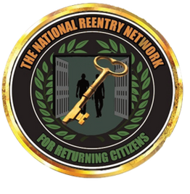


The National Reentry Network for Returning Citizens
Organizational Overview
Presentation - 2025
www.thenationalreentrynetwork.org
202-584-1000

Slide 2
Jarnese Harris
Executive Assistant
Organizational Chart
Rene Bost
Treasurer
Foster Sellers
Program Coordinator
Chiquisha Robinson
Secretary & legal Advisor
Zachary Ragone
Policy Director
Trone Harrington
Outreach Specialist
Courtney Stewart
Chairman/CEO
Marcy Mistrett
Acting Treasurer
Zachary Talamonti
Wellness Coach
Mercedes Mendez
Returning Citizen
Laura Garvin
Administrative Assistant
Ernest Glover
Returning Citizen Advisor
Shayla Pratt
Outreach Team Member
Cordero Tann
Outreach Team Member

Slide 3


Vision and Mission
Vision
Mission
Our vision is to reinvest in safe and healthy communities, create more living wage jobs, permanent housing, and economic self-sufficiency for returning citizens.
Our mission is to build a strong, national network comprised of individuals returning from incarceration who support each other's reintegration. We use a client-centered approach to identify basic needs and to create a continuum of care that can address barriers to reentry, promote restorative practices, and reduce recidivism.

Slide 4







Our Values
We Believe In ...
The empowerment of returning citizens to have control over their own futures.
In redemption and second chances (forgiveness, love and new life).
The power of networking among returning citizens to ensure successful reentry.
That it is imperative to support organizations led by returning citizens and to elevate their leadership.
In prevention and alternatives to prison (reducing crime and recidivism).
That impacted citizens should have an equal and valued voice at policy making tables.
We support the full reentry of returning citizens into the civic, economic, and family structures upon their release.

Slide 5

History
The NRNRC was created by and for returning citizens as a volunteer organization. At the time, we focused on drug use, addiction, and voting rights.
Our Board of Directors is established, and we began to offer services at their recommendation. We then become a nonprofit 501 (c)(3) organization.
The Ready4Work Program and Peer Navigator Program are created and implemented. These programs assist returning citizens in finding employment and navigating the challenges of reentry.
We are currently in our 15th year of providing reentry services in DC. We have developed and implemented a variety of services that address the barriers to reentry and continue to do so today.
2010
2016
2019
Present

Slide 6


Accomplishments
Voter Registration and Education
85% Job Placement
15 years sustained performance
Ban the Box
D.C. Jails and Justice Task Force
Record Sealing and Expungement

Slide 7
Accomplishments - Ballot Initiatives
Fare Evasion
N.E.A.R Act
Restore the Vote
$15 Minimum Wage
Second Look Amendment
Initiative Four
Restore Act
Initiative 77

Slide 8





Signature Programs
Peer Navigator
Ready4Work
A formal mentorship program between a member of the community who has experienced reentry and a current returning citizen. The mentee is guided towards stability and creates their own goals and direction throughout 12 months.
The Ready4Work Program is a comprehensive
5-week Job Readiness/ Job Placement Program. It is held on Monday and Thursday from 10 AM-1 PM and Tuesday and Wednesday from 10 AM-2 PM. The program provides each participant with a $10.50/hr stipend. Clients will have access to our Peer Navigator program for up to a 1 year after enrollment in the Ready 4 Work cohort.
Restorative Justice
Community Led Preventive Model
Reintegration support circles are a way to have a network of people who care about your success come together to support your transition home. Your circle will build stronger relationships, identify issues and solutions, write a plan and follow up on the plan so that everyone in the circle is working for your success.
This model uses a mustard-seed approach to engage the community to determine their needs and address instances of harm. This is a preventive model, with the aim to reduce interactions with the criminal legal system before they can occur.

Slide 9

Signature Programs cont.
Reentry Helpline
The National Reentry Network for Returning Citizens helpline is a free, confidential 24-hour-a-day, 365-day-a-year, information service for returning citizens reentering the community who are in need of reentry services. This service provides resources and referrals for employment, job training, family reunification, apprenticeship programs, food pantry, clothing, housing, mental health and/or substance abuse support. This service is provided to particularly aid those who are within the first 72 hours of their release, although any returning citizen can benefit from this service.
Call Us at 1-844-916-2577
National Reentry Network Membership
Currently, we are focusing on building a membership platform intended to serve our returning citizens and their families indefinitely. We strive to be there for our returning citizens and their communities, no matter the obstacle. Therefore, through our membership platform, we’ll be able to offer a consistent and effective support system for all returning citizens.

Slide 10
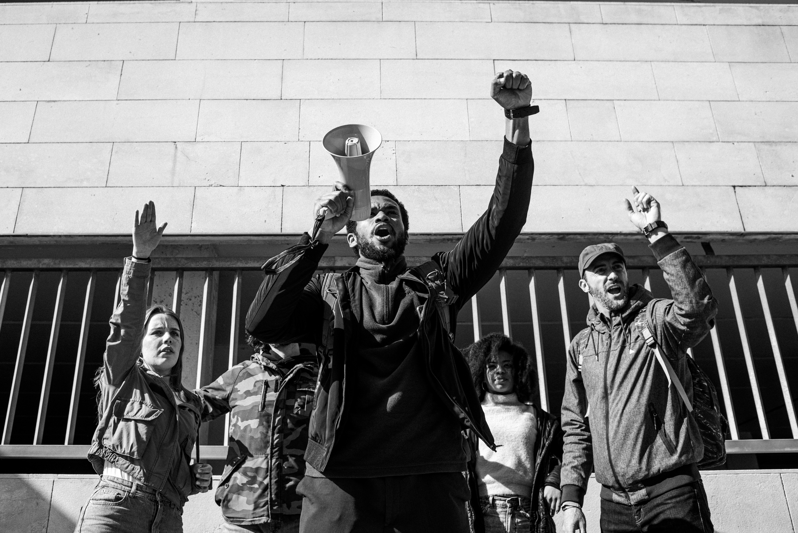

Advocacy
Educating the public
We work to educate the public on the consequences of our current criminal legal system and the process of political advocacy. We participate in community conversations where a variety of information and opinions are shared.
Safe & Free DC Program
We support the 18 bills contained in the Solutions for a #SafeAndFreeDC legislative agenda and are committed to advancing true safety and freedom for all in our own work, collaborations, and the movement at large.
Changing the narrative
DC Jails and Justice Task Force
We work to advocate for change in the narrative that is placed upon returning citizens and justice-involved individuals. We elevate stories of success through our Black Table Talk publications.
In partnership with the Council for Court Excellence and the Vera Institute of Justice, an independent advisory committee was formed. This Task Force is dedicated to redefining and reinventing our local approach to corrections, ensuring that our jail is one part of a just and equitable overall system.
Changing the Language
We work to advocate for change in the language used to refer to justice-involved individuals and returning citizens in legislation and society. We spread awareness on how language can create bias and prejudice against these communities.
Unlock the Box
We are a part of a coalition of organizations and movement leaders who partner with state and local campaigns across the United States with the common goal of ending the use of solitary confinement for all people.
Policy and legislation
We advocate for and play a part in the passing of policies and legislation that advances the rights of returning citizens and eliminates barriers to reentry.

Slide 11
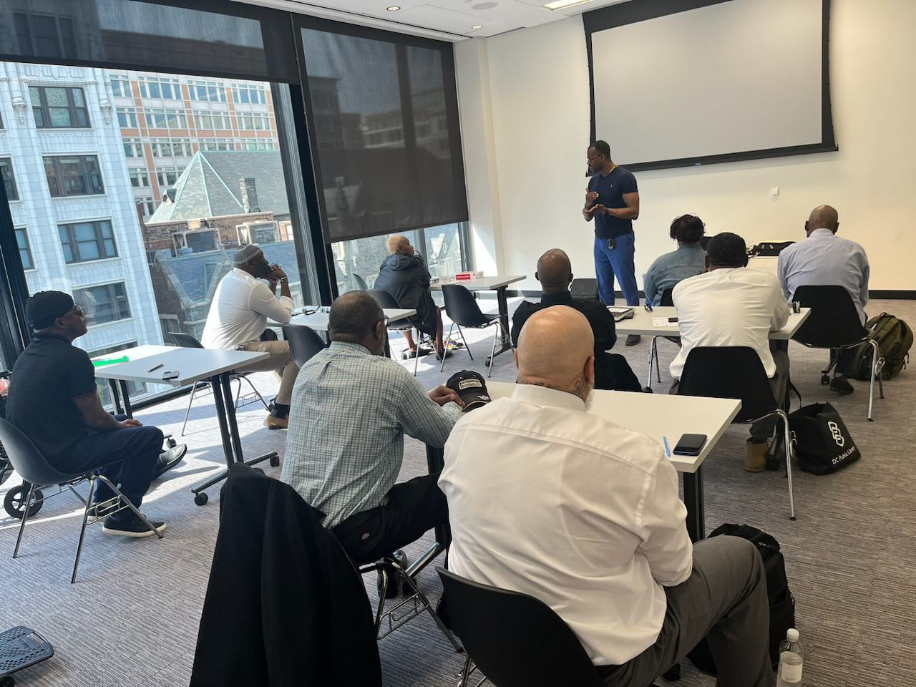
Ready4Work
Evidence-based 5-week cohort that prepares returning citizens for the workplace. The curriculum includes:
Resume and interview preparation
Financial literacy
Job placement and coaching
Emotional intelligence and conflict resolution skills
Teambuilding
Leadership development
Entrepreneurship

Slide 12

Peer Navigator Program
The returning citizen, (the mentee), defines their direction and goals while the mentor guides the mentee through their reintegration into the community.
The mentor and mentee will be required to conduct 2-4 hours per week of contact.
The contact may include, but is not limited to, telephone conversations and social visits (Cultural, Arts, Entertainment and Education), and may also include classroom work in the Ready4Work training.
This relationship between the mentor/mentee is a 12-month commitment but also comes with a continuum of care after the end of that time period.

Slide 13

Restorative Justice Model
You, your case worker and a facilitator will be part of your circle. You will identify 1-3 other people to invite to participate in your support circle.
Family members
Friends/mentors
Pastors/Church members
Service providers
12-step sponsors
Other supporters
Each of these people will learn about the circle and make a commitment to participate on a regular basis. With the help of a facilitator, your circle will meet regularly for 3 months to a year, depending on what feels right to the group and to you.

Slide 14

Reintegration Circles
Offer a space for returning citizens to connect with their personal support network and work towards achieving stability.
Circle Keeping promotes restorative justice, violence intervention and reconciliation in relationships, builds community, and creates healthy communication among members.
Circles meet in prison and after release to offer a continuum of care.
Certified facilitators are trained to run Reintegration Circles to meet the needs of those involved.

Slide 15





Community-Led Preventative Model
The CLPM uses restorative practices to help rebuild community by focusing on ways harm can be reduced and repaired. The root cause of harm is examined, and relationships are built through the process of circle keeping.
Identify harm in the community
NRNRC will collect data and lead community circles to identify types of harms happening in our community.
Create a Referral Pathway
NRNRC will partner with community stakeholders to develop ways that businesses and community members can reach out to the Engagement Team.
Select and Train Engagement Team
Our model trains returning citizens from DC in circle keeping practices. A CLPM requires that those closest to the problem drive the solution.
Ecosystem of Care
Partners commit to pursuing progress at the rate of relationships, allowing time for the Engagement Team to establish trust in the community. The program develops collective understanding of the individual roles community members play in supporting a CLPM.
Hold Community Building Circles
NRNRC brings community members together to discuss community needs and build trust and understanding about the CLPM, circle keeping, and alternative ways to heal from conflict.

Slide 16




Peer Navigator
Guidance and support is provided by a mentor who has successfully navigated reentry.
Mentors serve as trusted navigators addressing the barriers of returning home.
The returning citizen and mentor are required to connect for 2-4 hours per week over a 12-month period. A continuum of care is provided after the end of the formal mentorship.
Promotes a healthy lifestyle of stability and helps returning citizens accomplish their goals.

Slide 17




Family Reunification
Increasing the frequency of visits leading up to reunification.
Early and diligent search for extended family members and use of kinship.
Participate in family team meetings to facilitate reunification efforts. This includes family group conferencing and family group decision making.

Slide 18
Partners and Affiliates
Public Welfare Foundation
Circle of Justice Innovations (CJI)
It Takes A Village Collaborative
ServeDC (CNCS AmeriCorps)
Office of Victim Services and Justice Grants (OVSJG)
Diverse City Fund
Open Society Foundation
Core DC
Council for Court Excellence (CCE)
Reentry Action Network (RAN)
Voices for a Second Chance (VSC)
ONE DC
DC Jobs with Justice (DCJWJ)
Public Defender Service (PDS)
Washington Lawyers Committee
England Family Foundation
Washington Community Foundation
Justice Policy Institute (JPI)
American Civil Liberties Union
DC Reentry Task Force
ReThink Justice DC
Reentry Council
Reentry Steering Committee
Council for Court Excellence
Core DC
Criminal Justice Coordinating Council
Corrections Offender Supervision Agency
Commission on Reentry
Georgetown University Justice Initiative
Open Society Foundation Justice Roundtable
Corrections Information Council
DC Justice Collaborative
Housing Urban Development
So Others May Eat
Reunion
DC Recovery Community Alliance
Women Involved in Reentry Efforts (W.I.R,E.)
MBI Health Services
Washington Interfaith Network (WIN)
Mayors Office On Returning Citizens Affairs
Department of Correction
Portal of Entry

Slide 19

Contacts
Courtney Stewart, Chairman/CEO cstewart@thereentrynetwork.org
Trone Harrington, Outreach Specialist
tharrington@thereentrynetwork.org
Jarnese Harris, Executive Assistant
jharris@thereentrynetwork.org
Zachary Talamonti, Wellness Coach
ztalamonti@thereentrynetwork.org
Zachary Ragone, Policy Director
zragone@thereetnrynetwork.org
Laura Garvin, Administrative Assistant
lgarvin@thereentrynetwork.org
Foster Sellers, Program Coordinator
fsellers@thereentrynetwork.org
Shayla Pratt, Outreach Team Member
spratt@thereentrynetwork.org
Cordero Tann, Outreach Team Member
ctann@thereentrynetwork.org
Instagram: @nationalreentrynetwork
Twitter: @reentrynetwork
Facebook:@thenationalreentrynetwork
TikTok: @nationalreentrynetwork
YouTube: @NRNRCBlackTableTalk

Slide 20
The National Reentry Network for Returning Citizens
Thank You
For Your Attention
www.thenationalreentrynetwork.org
202-584-1000

